Slide 2
EROOR501
Devam Srivastava
Hemangi Rudhankar
Aryan Saini
Yash Trivedi

Slide 3

Problem Statement
Carbon Negative Emission
Carbon emissions from human activities cause climate change and its adverse impacts on the planet and its inhabitants, necessitating immediate action to reduce and ultimately eliminate these emissions.

Slide 4

Solution Statement
To achieve carbon negative emissions, it is important to reduce greenhouse gas emissions first, as this will reduce the amount of CO2 that needs to be removed. This can be done through measures such as promoting the use of renewable energy, implementing energy efficiency measures, and reducing waste.

Slide 5

Tech Stacks
SOFTWARE
HTML
CSS
JAVASCRIPT

Slide 6
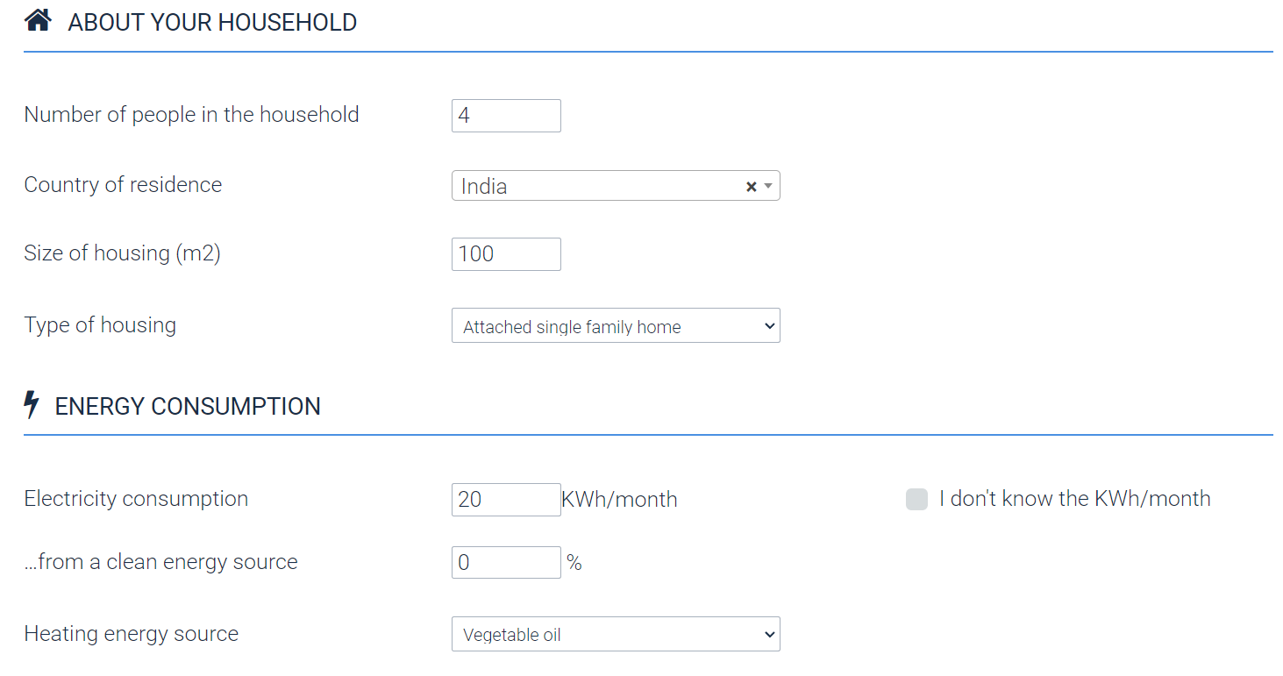
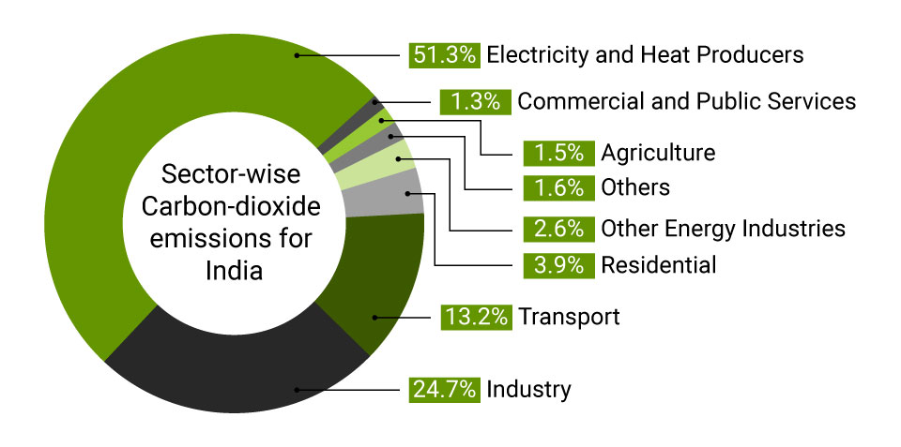
Wireframing/Architecture of the project flow

Slide 7
Future Scope of the Project
Integration with smart home devices
Use in corporate sustainability reporting
Integration with transportation apps
Adoption by governments
Integration with blockchain technology

